Slide 1
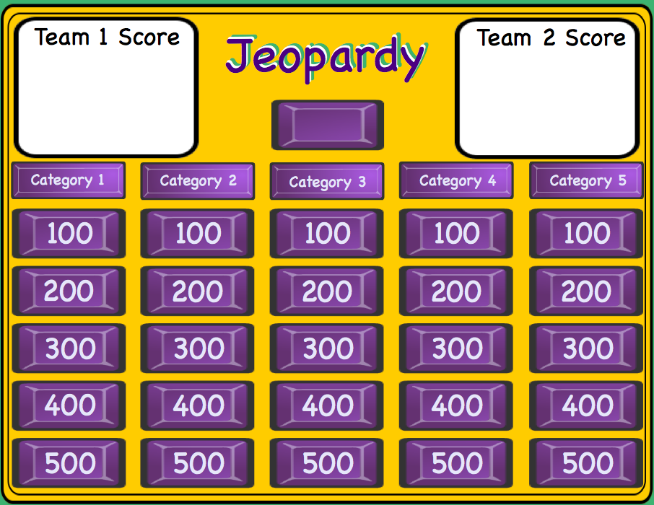
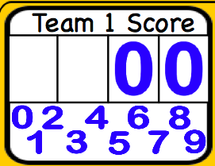
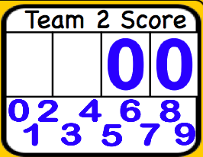
Smartboard Jeopardy
Smartboard Jeopardy
Lesson notes
Lesson notes
L. Harvey Almarode
Instructor
L. Harvey Almarode
Instructor
Memorial Hall 3625D
MSC 6907
Harrisonburg, VA 22807
540-568-4550
almarolh@jmu.edu
almarolh.googlepages.com

Slide 2
Lesson Notes
Lesson Notes
Directions for using this Smartboard Jeopardy template.
Double click on the Category names to edit and change.
Edit each of the Question pages with the Question and Answer. You must move the purple reveal box to enter the correct response, then move the reveal box over the answer until it is covered. After all questions are entered Save As ... and give it another name. This helps preserve the template.
The blank purple button in the center of the Jeopardy board is an Infinite Cloner and is used to place over the question button when you return to the Jeopardy Board. This shows that this button has been chosen and can not be chosen again.
The white cells are for the score keeper to keep score of the teams. Drag the numbers to the cell to change score. Drag the white rectangle to the cell to delete score.
Jeopardy Board

Slide 3
Team 1 Score
Jeopardy
Team 2 Score
Jeopardy
Jeopardy
5 Themes
Geography
Time
Tools
Lat/Long
100
100
100
100
100
200
200
200
200
200
300
300
300
300
300
400
400
400
400
400
500
500
500
500
500

Slide 4
5 Themes 1 - 100
The position of a place on Earth's surface.
Location
Jeopardy Board
move to reveal
move to reveal

Slide 5
5 Themes 1 - 200
How people affect their environment and how their environment affects them.
Interaction
move to reveal
Jeopardy Board
move to reveal

Slide 6
5 Themes 1 - 300
How and why people, ideas, and goods move from place to place.
Movement
move to reveal
Jeopardy Board
move to reveal

Slide 7
5 Themes 1 - 400
Areas on Earth's surface that have several common characteristics.
Region
Jeopardy Board
move to reveal
move to reveal

Slide 8
5 Themes 1 - 500
Describes the characteristics of a location that make it unique or different.
Place
move to reveal
move to reveal
Jeopardy Board

Slide 9
Geo - 100
The study of Earth and its people.
Geography
move to reveal
move to reveal
Jeopardy Board

Slide 10
Geo - 200
This type of geography studies land area, bodies of water and natural resources.
Physical
move to reveal
Jeopardy Board
move to reveal

Slide 11
Geo - 300
Type of geography that studies religion, language and culture.
Human
move to reveal
Jeopardy Board
move to reveal

Slide 12
Geo - 400
Type of location that refers to the exact spot on Earth's surface.
Absolute Location
move to reveal
Jeopardy Board
move to reveal

Slide 13
Geo - 500
Refers to where something is in relation to other features.
Relative Location
move to reveal
move to reveal
Jeopardy Board

Slide 14
Time - 100
How long is a decade?
10 years
move to reveal
Jeopardy Board
move to reveal

Slide 15
Time - 200
A century is how many years?
100 years
move to reveal
move to reveal
Jeopardy Board

Slide 16
Time - 300
A millennium is how many years?
1,000 years
move to reveal
Jeopardy Board
move to reveal

Slide 17
Time - 400
How long does it take earth to make one revolution around the sun?
365 1/4 days
Jeopardy Board
move to reveal
move to reveal

Slide 18
Time - 500
A year that contains an extra day.
Leap Year
move to reveal
Jeopardy Board
move to reveal

Slide 19
Tools - 100
System that uses radio signals to determine the exact location of places on Earth.
GPS
move to reveal
Jeopardy Board
move to reveal

Slide 20
Tools - 200
Computer hardware and software that gather, store, and analyze information.
GIS
move to reveal
move to reveal
Jeopardy Board

Slide 21
Tools - 300
A round model of the earth.
Globe
move to reveal
Jeopardy Board
move to reveal

Slide 22
Tools - 400
A flat drawing of the Earth's surface.
Map
Jeopardy Board
move to reveal
move to reveal

Slide 23
Tools - 500
One problem with maps is that they ___________shapes and sizes of Earth's features.
distort
move to reveal
Jeopardy Board
move to reveal

Slide 24
Lat/Long - 100
Latitude and longitude are best used for which of the 5 themes?
location
move to reveal
move to reveal
Jeopardy Board

Slide 25
Lat/Long - 200
Line of latitude that is 0 degrees.
Equator
move to reveal
Jeopardy Board
move to reveal

Slide 26
Lat/Long - 300
0 degrees longitude.
Prime Meridian
Jeopardy Board
move to reveal
move to reveal

Slide 27
Lat/Long - 400
The Prime Meridian and Equator divide the Earth into...
hemispheres
move to reveal
Jeopardy Board
move to reveal

Slide 28
Lat/Long - 500
This line of longitude is where a new day starts.
International Date Line
move to reveal
Jeopardy Board
move to reveal

Slide 29
Final Jeopardy
Fill in the blanks
The reason for the ________ is the _______ of the earth. On June 21 we have the _______ solstice. Followed by an ______ where the sun is centered over the equator. Then we have another _______ on December 22 when winter begins. Followed by March 21 which is the start of ______.
Bonus 1,000 points:
What color is a polar bear's skin?

