Slide 1
Team 1 Score
Jeopardy
Team 2 Score
Jeopardy
Jeopardy
Language
Religion
Government
Vocab
Stuff
100
100
100
100
100
200
200
200
200
200
300
300
300
300
300
400
400
400
400
400
500
500
500
500
500

Slide 2
Language - 100
The most unifying aspect of culture
Language
Jeopardy Board
move to reveal
move to reveal

Slide 3
Language - 200
Which language has the most native speakers?
Mandarin
move to reveal
Jeopardy Board
move to reveal

Slide 4
Language - 300
This language has the most total speakers worldwide.
English
move to reveal
Jeopardy Board
move to reveal

Slide 5
Language - 400
There are approximately ______languages in the world today.
6900
Jeopardy Board
move to reveal
move to reveal

Slide 6
Language - 500
This language is most widely used on the internet.
English
move to reveal
Jeopardy Board
move to reveal

Slide 7
Religion- 100
There are approximately _________ religions in the world.
4200
move to reveal
Jeopardy Board
move to reveal

Slide 8
Religion - 200
The belief in one God.
monotheism
move to reveal
Jeopardy Board
move to reveal

Slide 9
Religion - 300
The belief in more than one God.
Polytheism
move to reveal
move to reveal
Jeopardy Board

Slide 10
Religion- 400
With 2.3 billion followers this is the world's most practiced religion.
Christianity
move to reveal
move to reveal
Jeopardy Board

Slide 11
Religion - 500
This religion follows Abraham.
Judaism
Jeopardy Board
move to reveal
move to reveal

Slide 12
Government - 100
This government has a king and queen.
Monarchy
move to reveal
move to reveal
Jeopardy Board

Slide 13
Government - 200
Government ruled by the people.
Democracy
Jeopardy Board
move to reveal
move to reveal

Slide 14
Government - 300
This government has an all-powerful ruler who is not elected.
Dictatorship
move to reveal
Jeopardy Board
move to reveal

Slide 15
Government - 400
Adolf Hitler was an example of which type of leader?
Dictator
move to reveal
move to reveal
Jeopardy Board

Slide 16
Government - 500
The United States has which type of democracy?
Representative
move to reveal
Jeopardy Board
move to reveal

Slide 17
Vocab - 100
This is a way of life of a group of people who share similar beliefs and customs.
Culture
move to reveal
move to reveal
Jeopardy Board

Slide 18
Vocab - 200
A highly developed culture.
Civilization
move to reveal
move to reveal
Jeopardy Board

Slide 19
Vocab - 300
Culture produces these that are both material and non-material.
Traits
move to reveal
Jeopardy Board
move to reveal

Slide 20
Vocab - 400
An area that includes different countries that share similar cultural traits.
Culture Region
move to reveal
move to reveal
Jeopardy Board

Slide 21
Climate - 500
A group that shares a language, history, religion and some physical traits.
Ethnic Group
move to reveal
move to reveal
Jeopardy Board

Slide 22
Stuff - 100
Two or more people who interact with one another, share similar characteristics.
Social Group
move to reveal
Jeopardy Board
move to reveal

Slide 23
Stuff - 200
A local form of a language.
Dialect
move to reveal
move to reveal
Jeopardy Board

Slide 24
Stuff - 300
A tradition like opening gifts at Christmas.
Custom
move to reveal
Jeopardy Board
move to reveal

Slide 25
Stuff - 400
The process of spreading ideas, language or customs from one culture to another.
Cultural Diffusion
move to reveal
move to reveal
Jeopardy Board

Slide 26
Stuff - 500
The development of a worldwide culture with an interdependent economy.
Globalization
Jeopardy Board
move to reveal
move to reveal

Slide 27
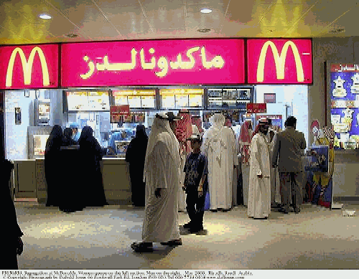
Final Jeopardy
Use geography terms to describe this picture. Teams will get 500 points for each correct term.

